Slide 1

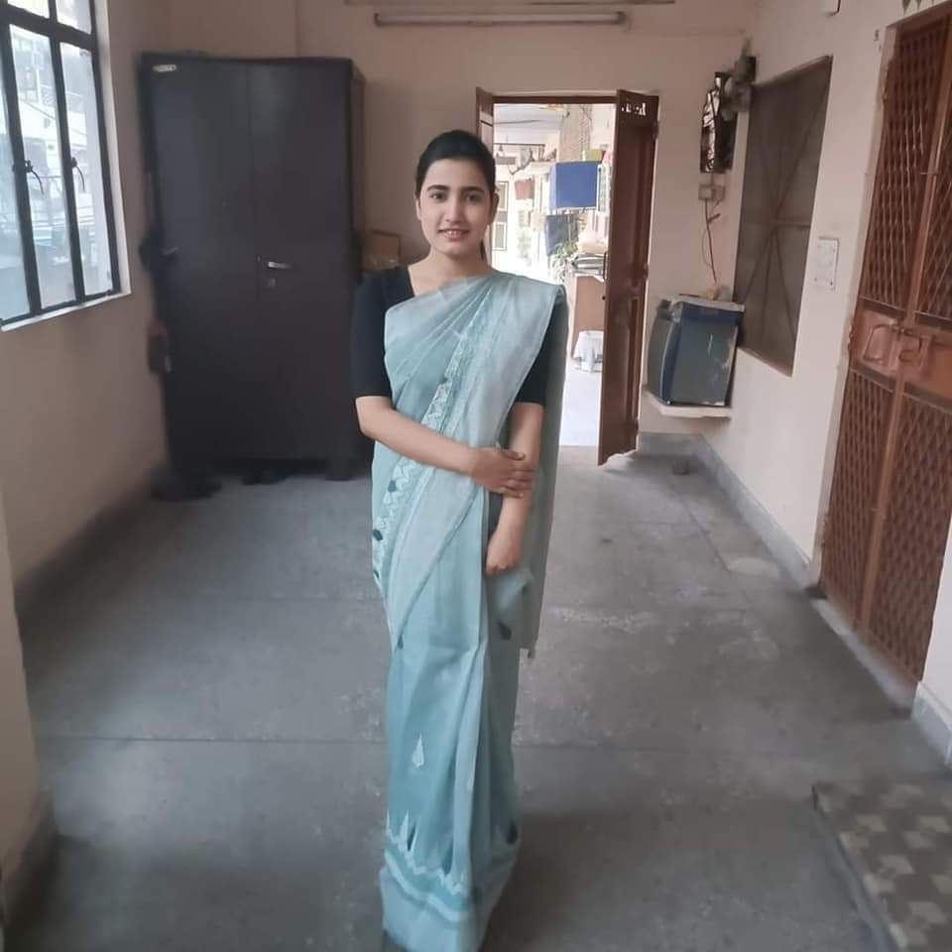
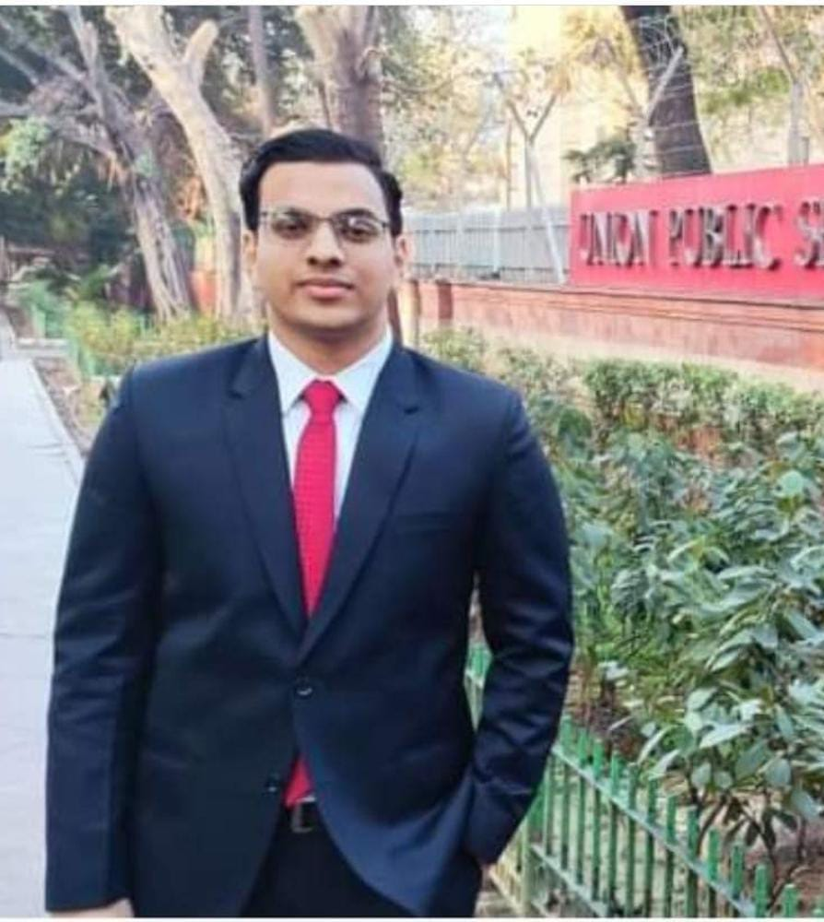
UPSC CSE Examination 2023 Achievers
Kalpana Pandey & Ishan Agarwal

Slide 2

Introduction
The UPSC civil services exam is considered one of the toughest exams in India. On average, candidates take more than 2 attempts to clear this exam. But every year, there are several candidates who clear the UPSC exam in their very first attempt. Some of them even go on to top the exam with high marks.
It takes a special kind of effort for candidates to crack the IAS exam in the very first attempt and secure the service of their choice.

Slide 3
Primary goals
Providing Quality Education

Slide 4
Education is the passport to the future, for tomorrow belongs to those who prepare for it today.
“
”
Aryabhatta College

Slide 5

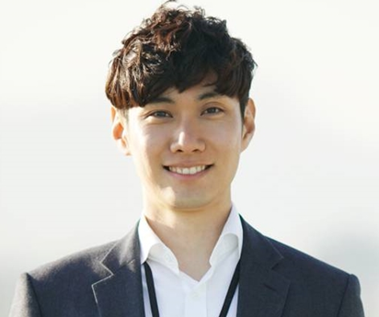

Meet our students
Kalpana Pandey UPSC Rank - 102
Ishan Agarwal UPSC Rank - 409
B.A Programme
Batch 2017-2020
College Roll No.- 17/BAPS/036
B.A Programme
Batch 2018-2021
College Roll No.- BAP/18/22

Slide 6

Summary
We at Aryabhatta, in addition to our focus on providing quality education at the undergraduate level, stand for inclusive growth and believe in providing ample opportunities to our students to assist them in discovering their potential appropriately. As a value-based institution we are dedicated towards inculcating, in all our students, a desire to evolve into responsible social beings.

Slide 7


Thank you
Aryabhatta College
admin@aryabhattacollege.ac.in
www.aryabhattacollege.ac.in

